Slide 1
19Z502 Microprocessors and Interfacing
Instruction Set
Dr.N.Arulanand
CSE, PSG CT

Slide 2
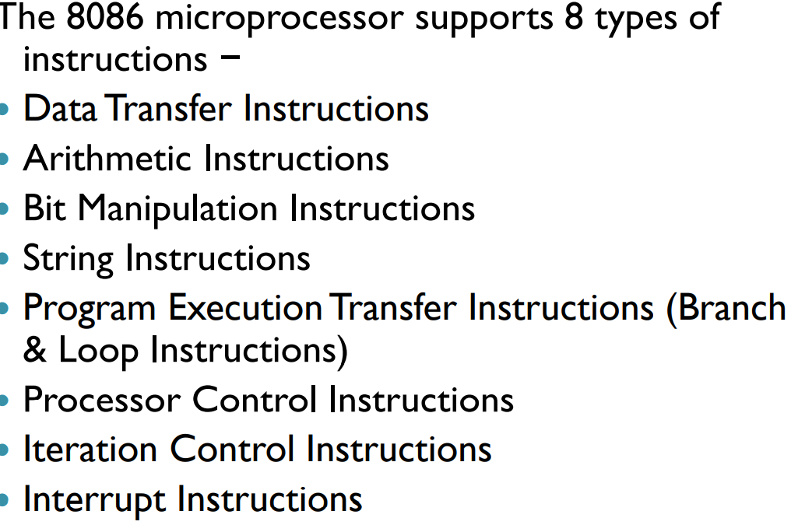
INSTRUCTION SET OF 8086

Slide 3
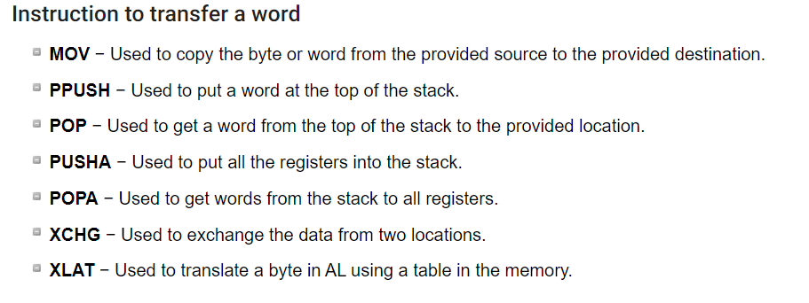
DATA TRANSFER INSTRUCTIONS

Slide 4
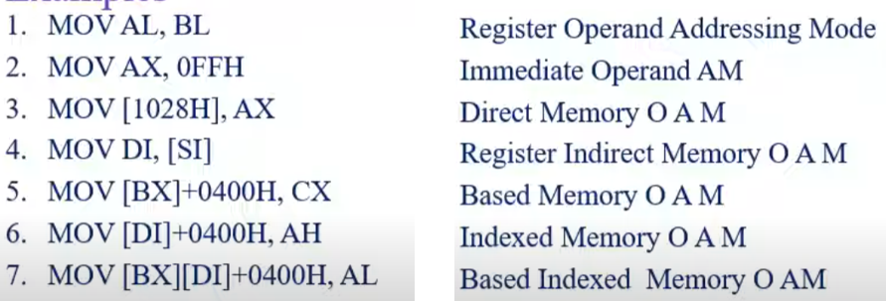
MOV INSTRUCTION - EXAMPLES

Slide 5
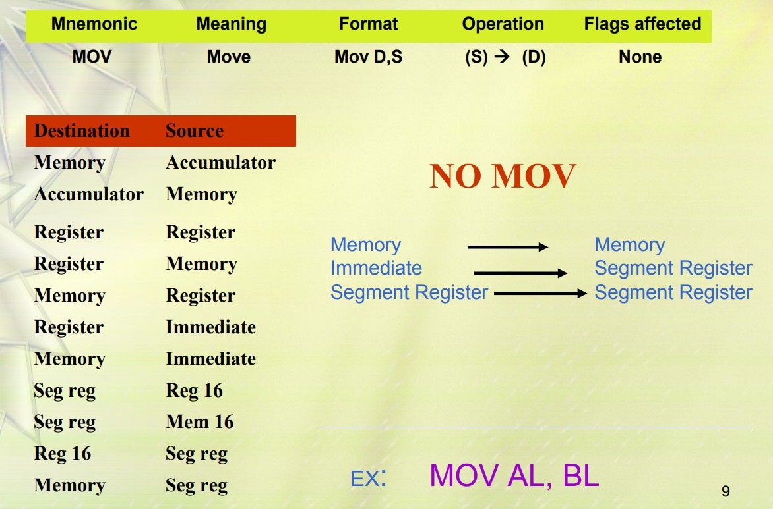
Data Transfer Instructions - MOV

Slide 6
MOV INSTRUCTION RULES
Both the operands must be of same size
No Memory to Memory moves
No Segment to Segment moves
Destination cannot be CS or IP
No immediate to segment moves
MOV instructions don’t affect the flag bits

Slide 7
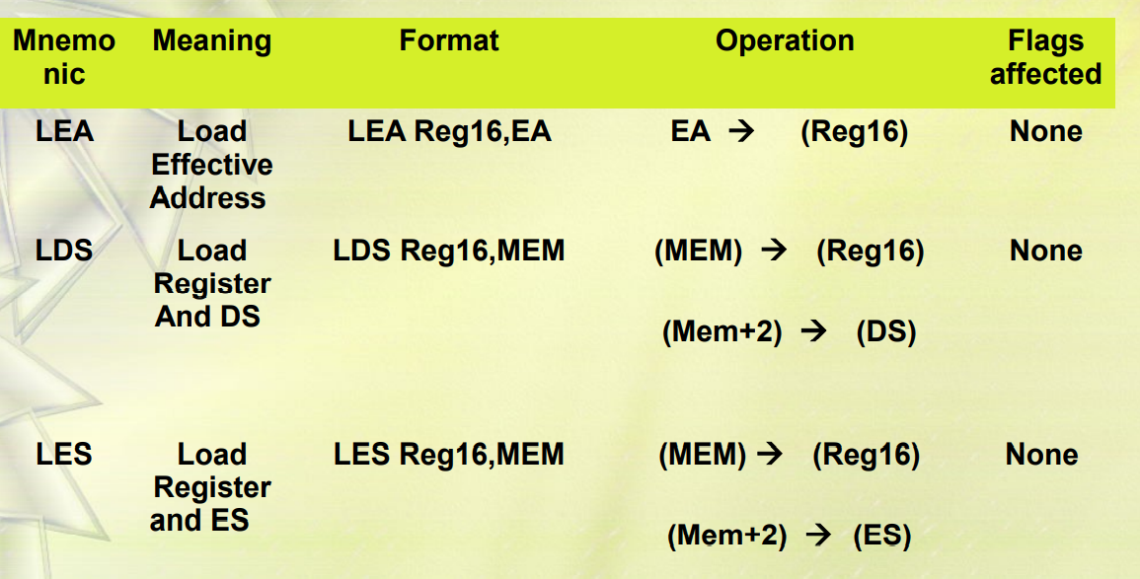
DATA TRANSFER INSTRUCTIONS

Slide 8
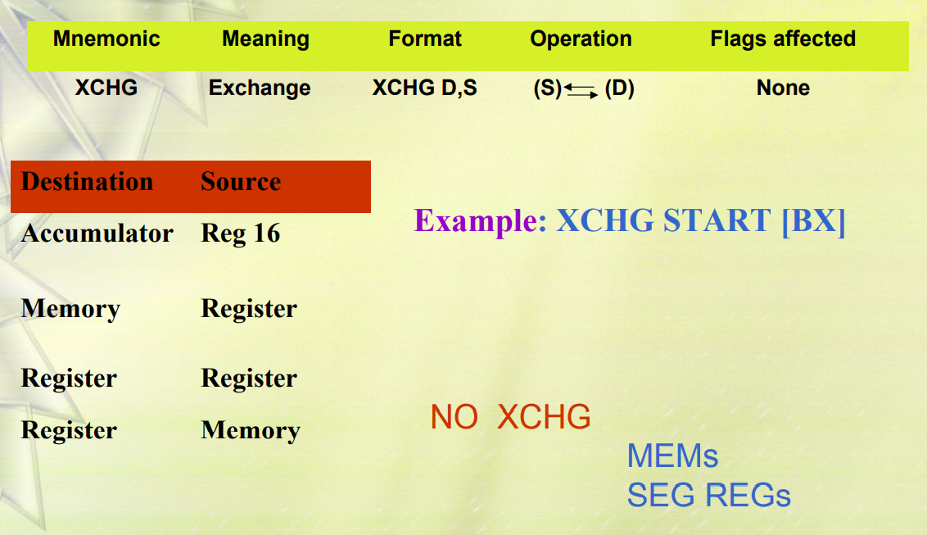
DATA TRANSFER INSTRUCTION - XCHG

Slide 9
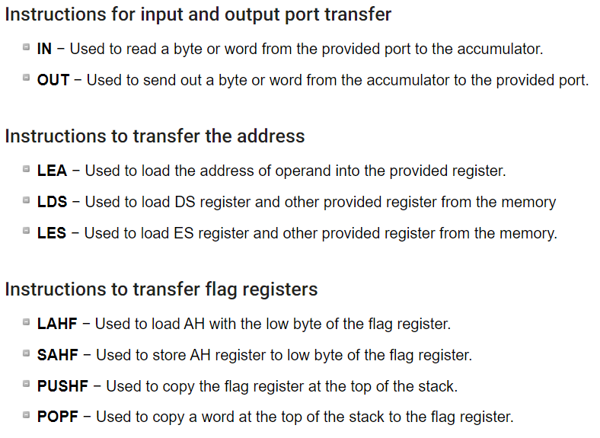
DATA TRANSFER INSTRUCTIONS

Slide 10
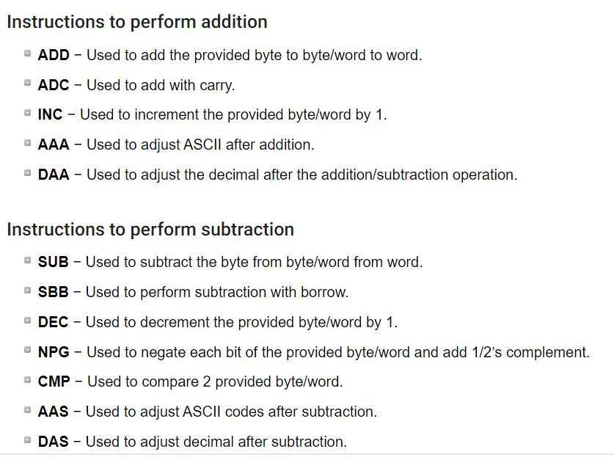
ARITHMETIC INSTRUCTIONS

Slide 11
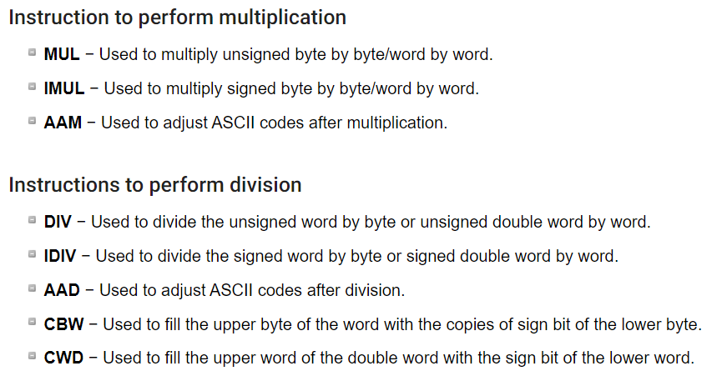
ARITHMETIC INSTRUCTIONS

Slide 12
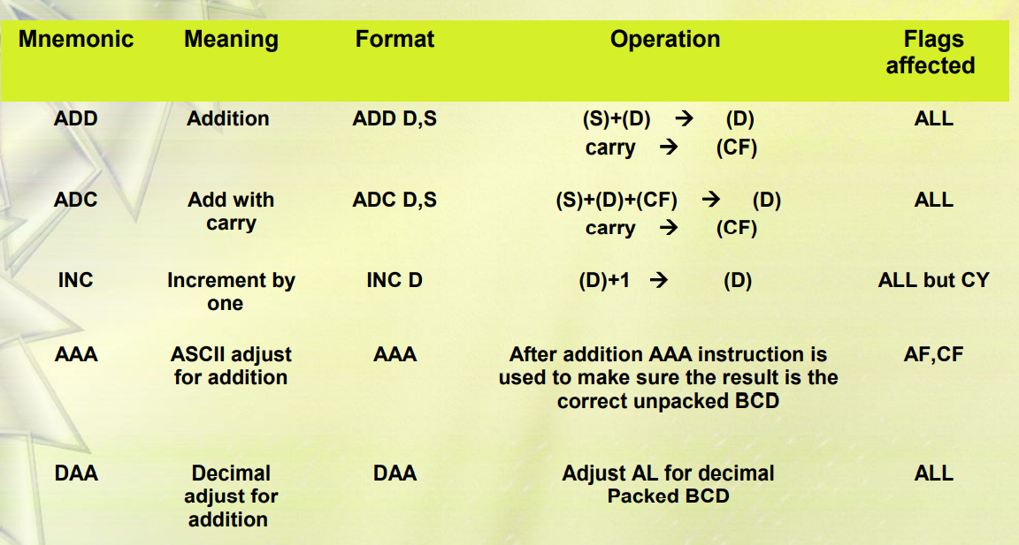
Arithmetic Instructions-ADD,ADC,INC,AAA,DAA

Slide 13
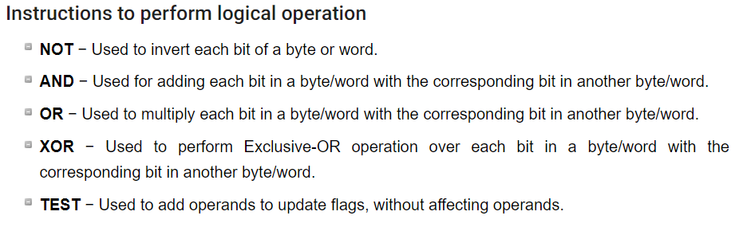
BIT MANIPULATION INSTRUCTIONS

Slide 14
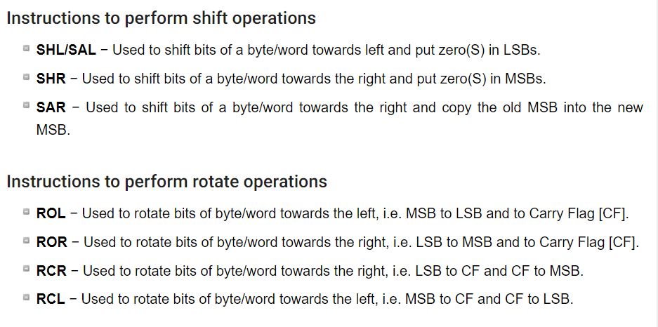
BIT MANIPULATION INSTRUCTIONS

Slide 15

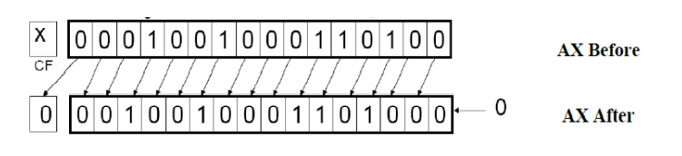
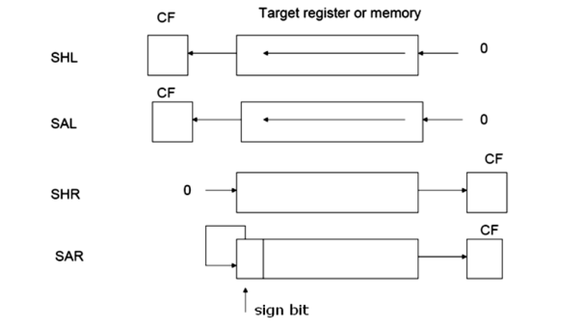

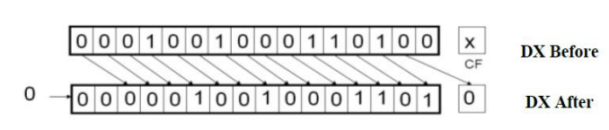
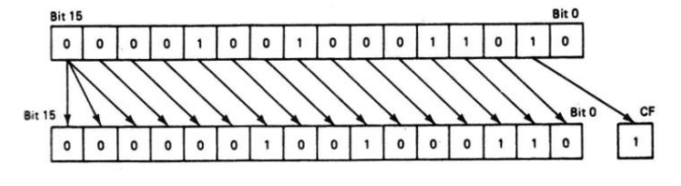
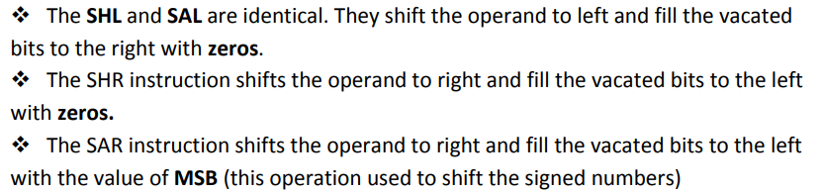
SHIFT INSTRUCTIONS

Slide 16

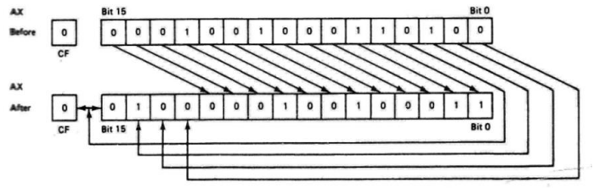
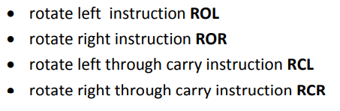

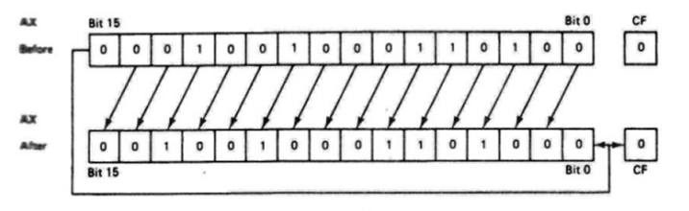

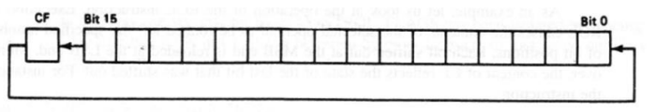
ROTATE INSTRUCTIONS

Slide 17
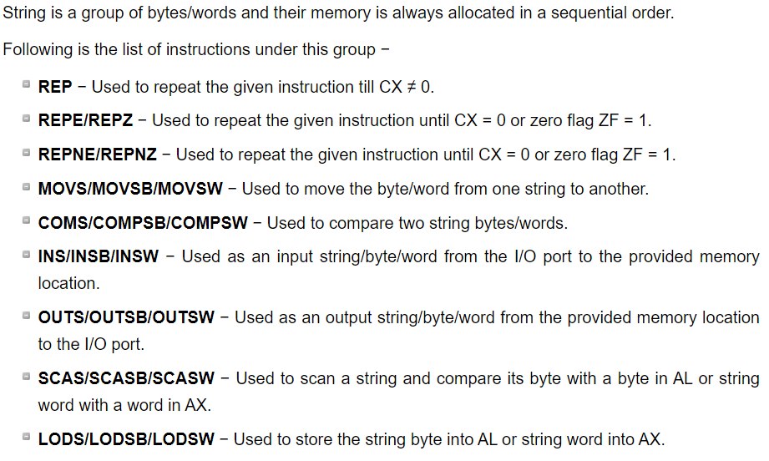
STRING INSTRUCTIONS

Slide 18
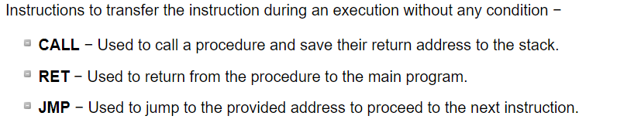
PROGRAM EXECUTION TRANSFER INSTRUCTIONS (BRANCH & LOOP INSTRUCTIONS)

Slide 19
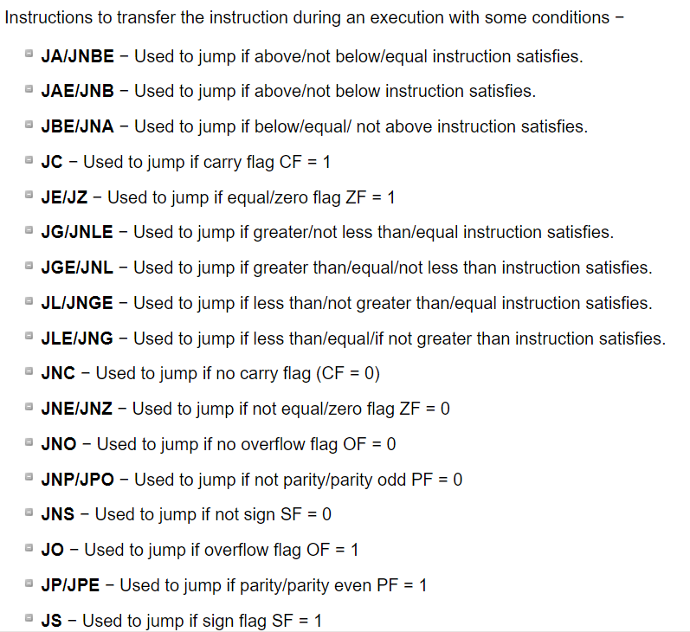
PROGRAM EXECUTION TRANSFER INSTRUCTIONS (BRANCH & LOOP INSTRUCTIONS)

Slide 20
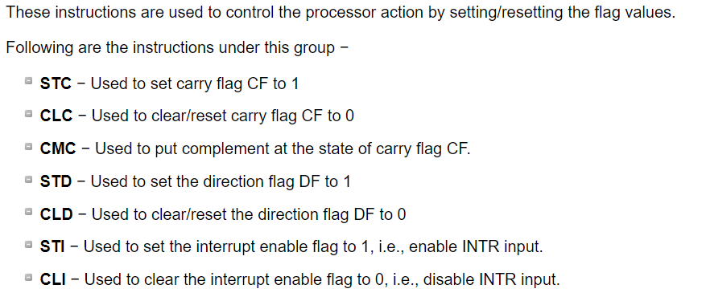
PROCESSOR CONTROL INSTRUCTIONS

Slide 21
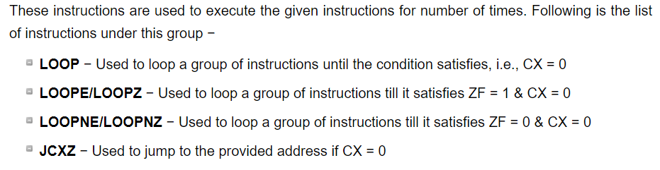
ITERATION CONTROL INSTRUCTIONS

Slide 22
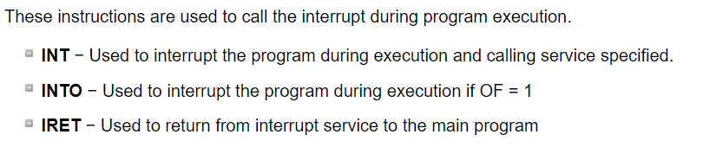
INTERRUPT INSTRUCTIONS

Slide 23
Homework
What is the difference between CF and OF flag ? (Carry Flag and Overflow Flag)
Write a program to multiply two numbers using SHIFT operation (without using multiplication operator) ?

